Slide 1
Classification Methods: A Short Review
Lecture # 8
PHYS 243

Slide 2
Types of ML
ML is divided into two types:
Supervised ML: Learn a mapping from inputs x_{i} to outputs y_{i}, given a labeled set of input-output pairs D = {(x_{i} , y_{i})}^{N} _{i=1} Here D is called the training set and N is the number of training examples.
Each training input x_{i} is a D-dimensional vector of numbers representing for example, the weight and height of someone. These are called features or attributes. These are stored in an N x D matrix, X. In general x_{i} could be anything – an image, a sentence a shape etc.

Slide 3
Similarly, the form of the output, y_{i}, can in principle be anything. In most methods y_{i} is assumed to be a nominal variable from some finite set y_{i} = {1,…,C}. When y_{i} is categorical, the problem is known as classification or pattern recognition. And when y_{i} is real-valued, the problem is known as regression.

Slide 4
Unsupervised ML: Here we are only given inputs D={x_{i}}^{N} _{i=1} and the goal is to find patterns in the data. Here we are not told what kind of patterns to look for and there is no obvious error metric to use (unlike supervised ML where we can compare our prediction y for a given x to the expected value).

Slide 5
Classification
The goal is to learn a mapping from inputs x to outputs y where y = {1,…,C} with C being the number of classes. If C=2, it is binary classification where y = {0,1}. If C>2 this is called multiclass classification. If the class labels are not mutually exclusive (tall and strong), it is called multi-label classification.

Slide 6
Examples of Classification
We have two classes of objects corresponding to labels 0 and 1.
The inputs are colored shapes. They are described by a set of D features, which are stored in an N x D design matrix X.
The input features x can be discrete, continuous or a combination of these two.
In addition to these, we have a vector of training labels, y.
The test cases here are a blue crescent, yellow circle and a blue arrow. None of these have been seen before.
Here, we need to generalize beyond the training set.
A reasonable guess is that the blue crescent should be y=1, since all blue shapes are labeled 1 in the training set. However, for the yellow circle, some yellow symbols are labeled y=1 and some y=0. Also, some circles are labeled y=1 and some y=0. Therefore, it is not clear what the right label should be in case of the yellow circle. Similarly the correct label for the blue arrow is unclear since all the blue things have y=1 label, all the arrows have y=0 label.
This requires a probabilistic prediction.

Slide 7
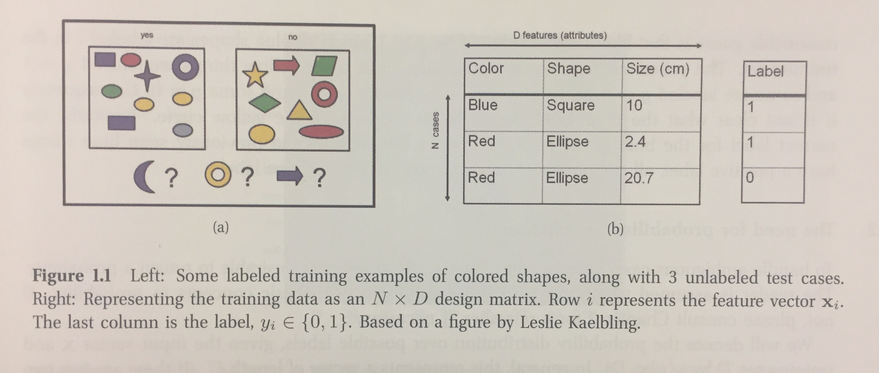
Figure from Machine Learning: A Probabilistic Perspective (Kevin. P. Murphy)

Slide 8
Probability distribution
In order to handle the ambiguous cases like the yellow circle, it is instructive to return a probability.
We denote the probability distribution over possible labels, given the input vector x and training set D by p(y | x,D). In general, this represents a vector of length C. If there were just two classes: p(y=1 | x,D) + p(y=0 | x,D) = 1.
This means that the probability is conditional on the test input x, as well as the training set D, by putting these terms on the right hand of the conditioning bar. Given a probabilistic output, we can compute our “best guess” as the “true label” using
y = argmax p(y=c | x, D)
This is the maximum probability of the label y having the value C, given the input x and the design matrix D. In other words, this is the most probable case and is called the mode of the distribution. In the above case, p(y | x,D) is very different from 1.0.

Slide 9
Example 1
Document classification:
Here the goal is to classify a document such as a web page or email message into one of C classes. This is to compute
p(y | x,D) where x is some representation of the text.
An example of this is to classify emails by defining a spam filter. There are two classes: spam (y=1) and non-spam (y=0).
Here we define x_{ij} = 1 if word j occurs in document, i. If we apply this transformation to every document in our dataset, we get a binary document co-occurrence matrix. The document classification problem is then reduced to the one that looks for subtle changes in the pattern of the bits.

Slide 10
Example 2
Classifying flowers:
The goal here is to distinguish between three different types of iris flowers by using some features or attributes of these flowers like, sepal length and width, petal length and width.
Based on these features we make a scatter plots. It seems that one type is separated from the other two. However, the other two flowers is hard to separate based on these features.

Slide 11
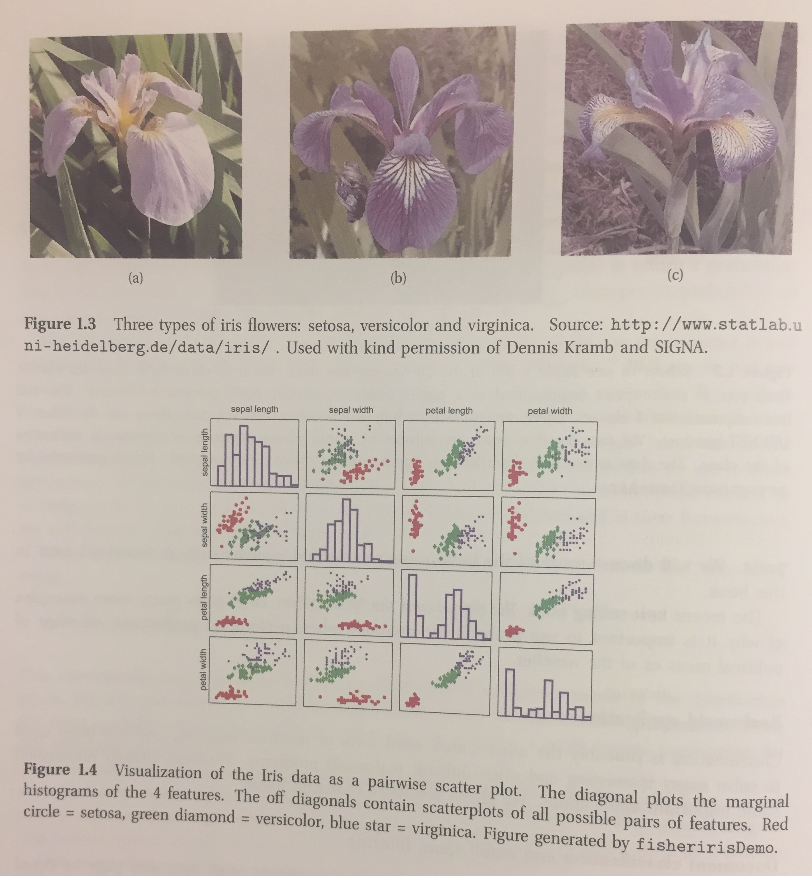
Classifying Flowers Figure from Machine Learning: A Probabilistic Perspective (Kevin. P. Murphy)

Slide 12
Regression
Regression is like classification except that the response variable is continuous. Here we have a simple real-valued input x_{i} and a single real-valued response y_{i}. We consider fitting two models to the data- a straight line and a quadratic function. Some applications of regression include:
Predict tomorrow’s stock market price, given current market conditions.
Predict the amount of prostate specific antigen (PSA) in the body as a function of a number of different clinical measurements.
Predict the temperature of any point inside a building using weather data, time, door sensors etc.

Slide 13
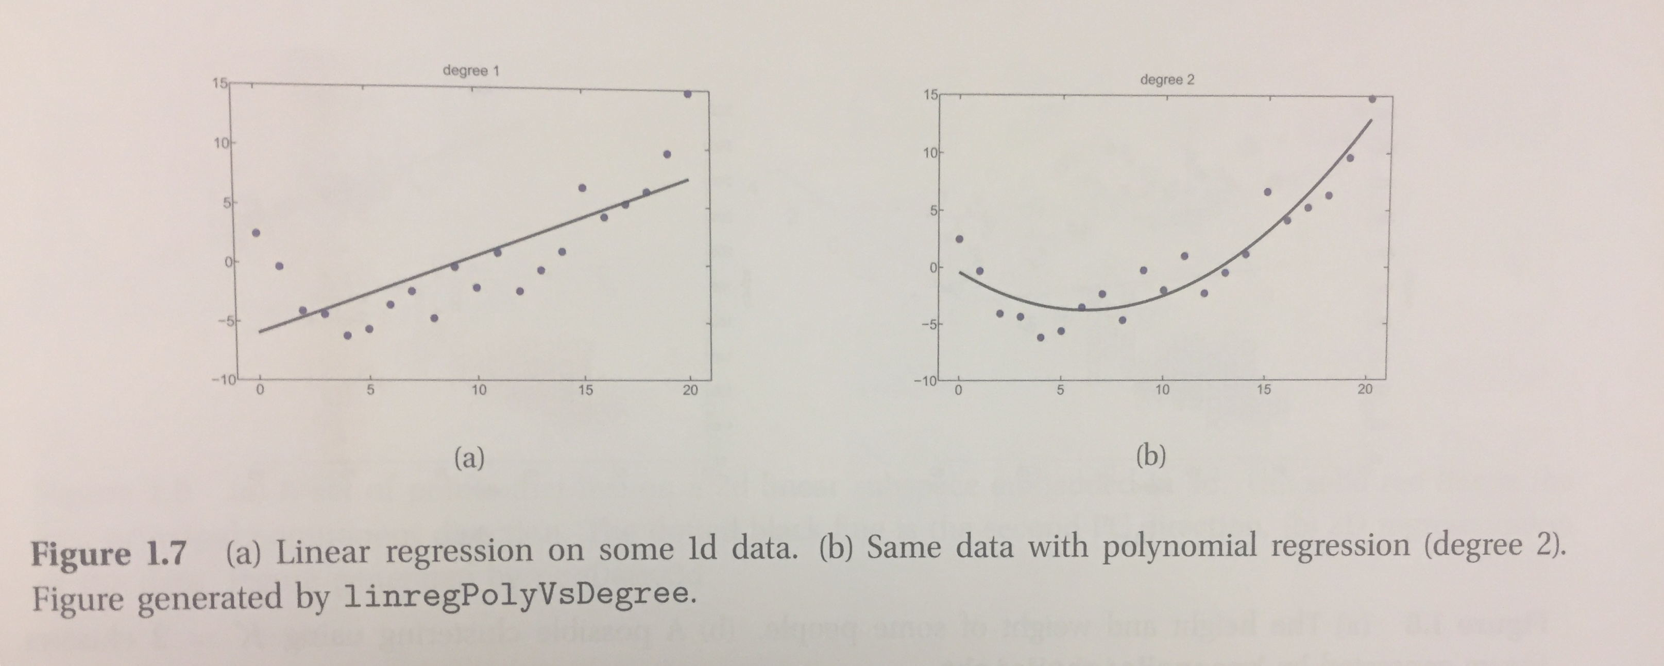
Figure from Machine Learning: A Probabilistic Perspective (Kevin. P. Murphy)

Slide 14
Unsupervised Learning
Here we are just given output data without any inputs. The goal is to discover structures in the data- so-called knowledge discovery. Unlike supervised learning, we are not told what the desired output is for each input. Instead, we will formalize our task as a density estimation, that is we want to build models of the form p(x_{i},q).
There are two differences between supervised and unsupervised learning. We express supervised learning as p(y_{i} | x_{i},q) and unsupervised learning as p(x_{i},q). Therefore, supervised learning is conditional density estimation while unsupervised learning is unconditional density estimation. Second, x_{i} is a vector of features. Therefore, we need to create multivariate probability models. By contrast, in supervised learning, y_{i} is just a single variable that we are trying to predict.
Unsupervised learning is typical of human and animal learning and is more widely applicable than supervised learning because it doesn’t need a human to manually label the data.

Slide 15
Examples of Unsupervised Learning
An application of unsupervised learning is the clustering of data into groups. For example, looking at the height and weight of a group of people, we may find various clustering of the data (or subgroups). Let K denote the number of clusters. Our first goal is to estimate the distribution over the number of clusters, p(K | D); this is to measure if there are subpopulations within the data. Our second goal is to estimate which cluster each point belongs to. Some applications of clustering include:
The clustering can be used in astronomy to measure the types of different stars based on the clustering of their astrophysical measurements.
In biology, one could cluster data into groups to discover different subpopulations of cells.

Slide 16
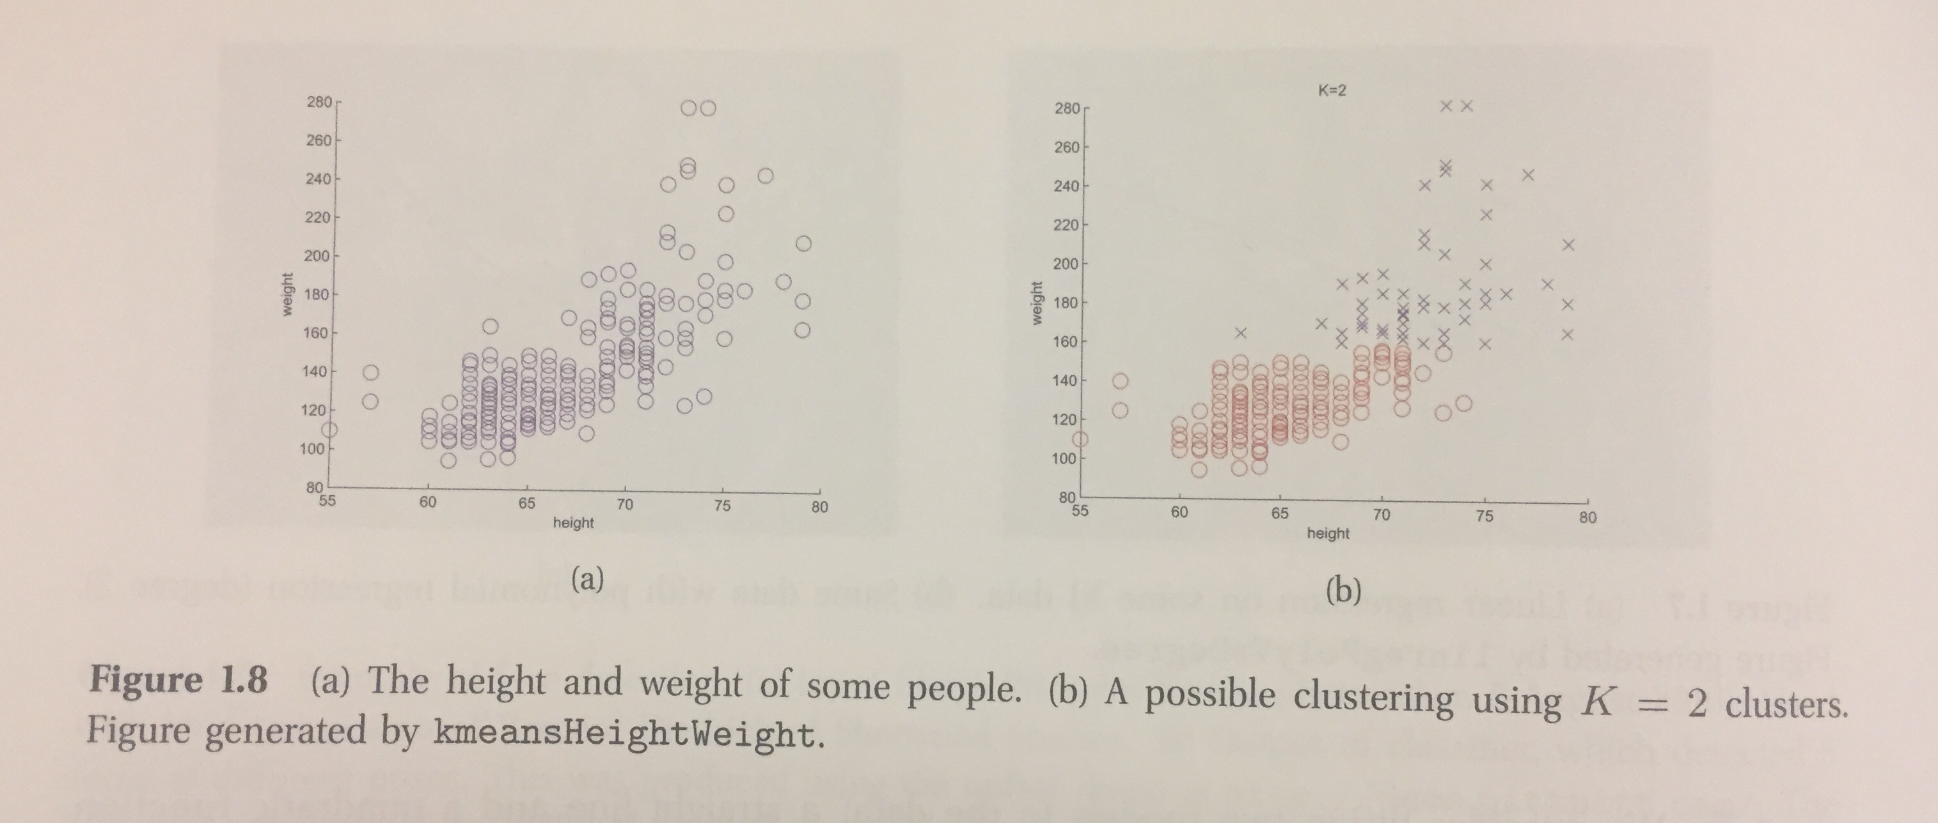
Figure from Machine Learning: A Probabilistic Perspective (Kevin. P. Murphy)

Slide 17
Dimensionality Reduction
When dealing with high dimensional data, it is often useful to reduce the dimensionality by projecting the data to a lower dimension subspace which captures the essence of the data. This is called dimensionality reduction. The most common approach of dimensionality reduction is Principle Component Analysis (PCA). This is an unsupervised version of multi-output linear regression. Dimensionality reduction and PCA have been applied in many cases.
For example:
In biology PCA is used to interpret gene microarray data to account for the fact that each measurement is the result of many genes that are correlated in their behavior by the fact that they belong to different biological pathways.
In computer graphics, it is common to project motion capture data to a low dimensional space and use it to create animations.

Slide 18
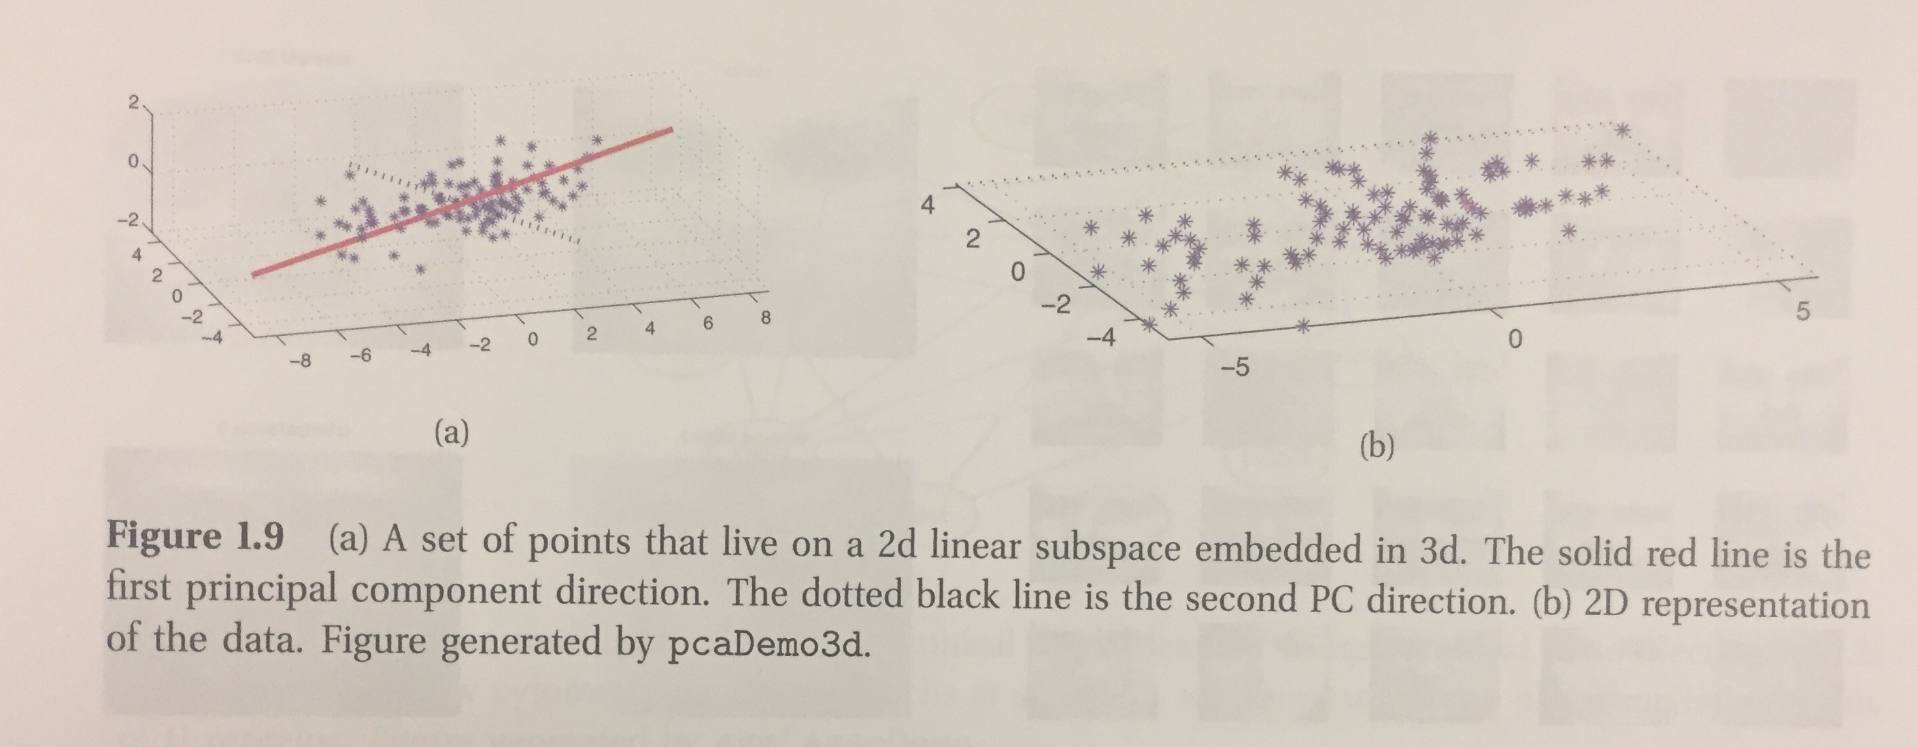
Figure from Machine Learning: A Probabilistic Perspective (Kevin. P. Murphy)

Slide 19
Basic Concepts in Machine Learning
We often deal with probabilistic models of the form p(y|x) or p(x), depending on whether we are interested in supervised or unsupervised learning respectively. The question is:
Does a model have a fixed number of parameters or does the number of parameters grow with the amount of training data?
The former is called parametric model and the later is called non-parametric model. Parametric models are faster to use but have the disadvantage that make stronger assumptions about the nature of the data distributions. Non-parametric models are more flexible but are computationally slow.

Slide 20
Example of A Non-Parametric Classifier: K Nearest Neighbors
The K Nearest Neighbors (KNN) is a simple non-parametric classifier. It looks at the K points in the training set that are nearest to the test input x, counts how many members of each class are in this set, and returns that empirical fraction as the estimate.
The KNN classifier with K=1 induces a Voronoi Tessellation of the points. This is a partition of space that associates a region V(x_{i}) with each point x_{i} in such a way that all points in V(x_{i}) are closer to x_{i} than to any other point. Within each cell the predicted label is the label of the corresponding training point.
The main problem with KNN classifiers is that they do not work well with high dimensional inputs. This is due to curse of dimensionality.

Slide 21
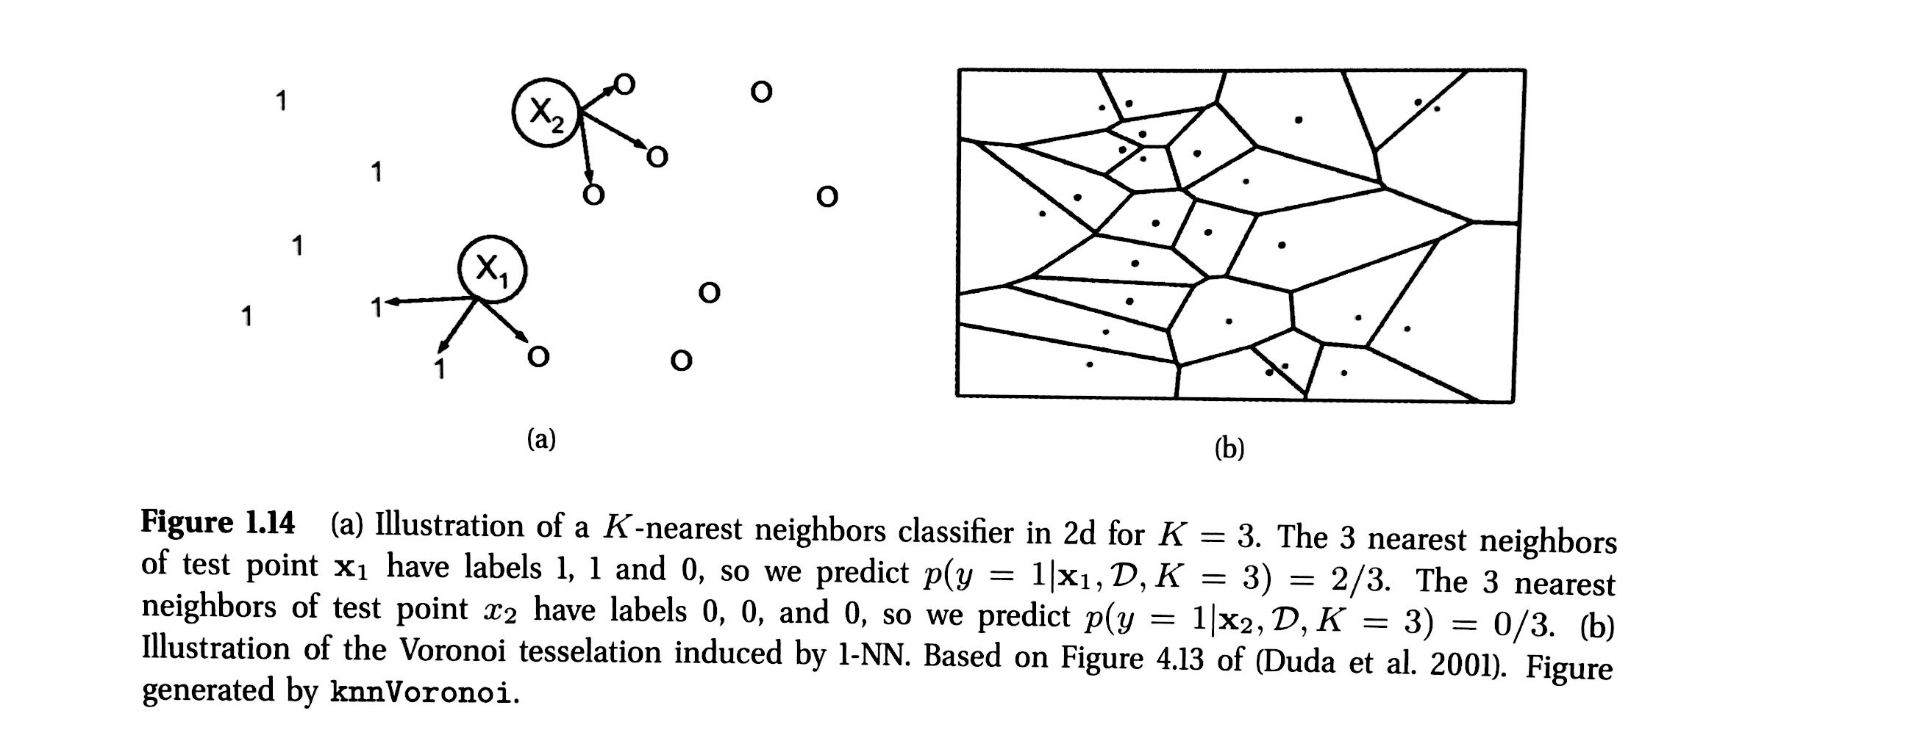
Voronoi Tesseletaion Figure from Machine Learning: A Probabilistic Perspective (Kevin. P. Murphy)

Slide 22
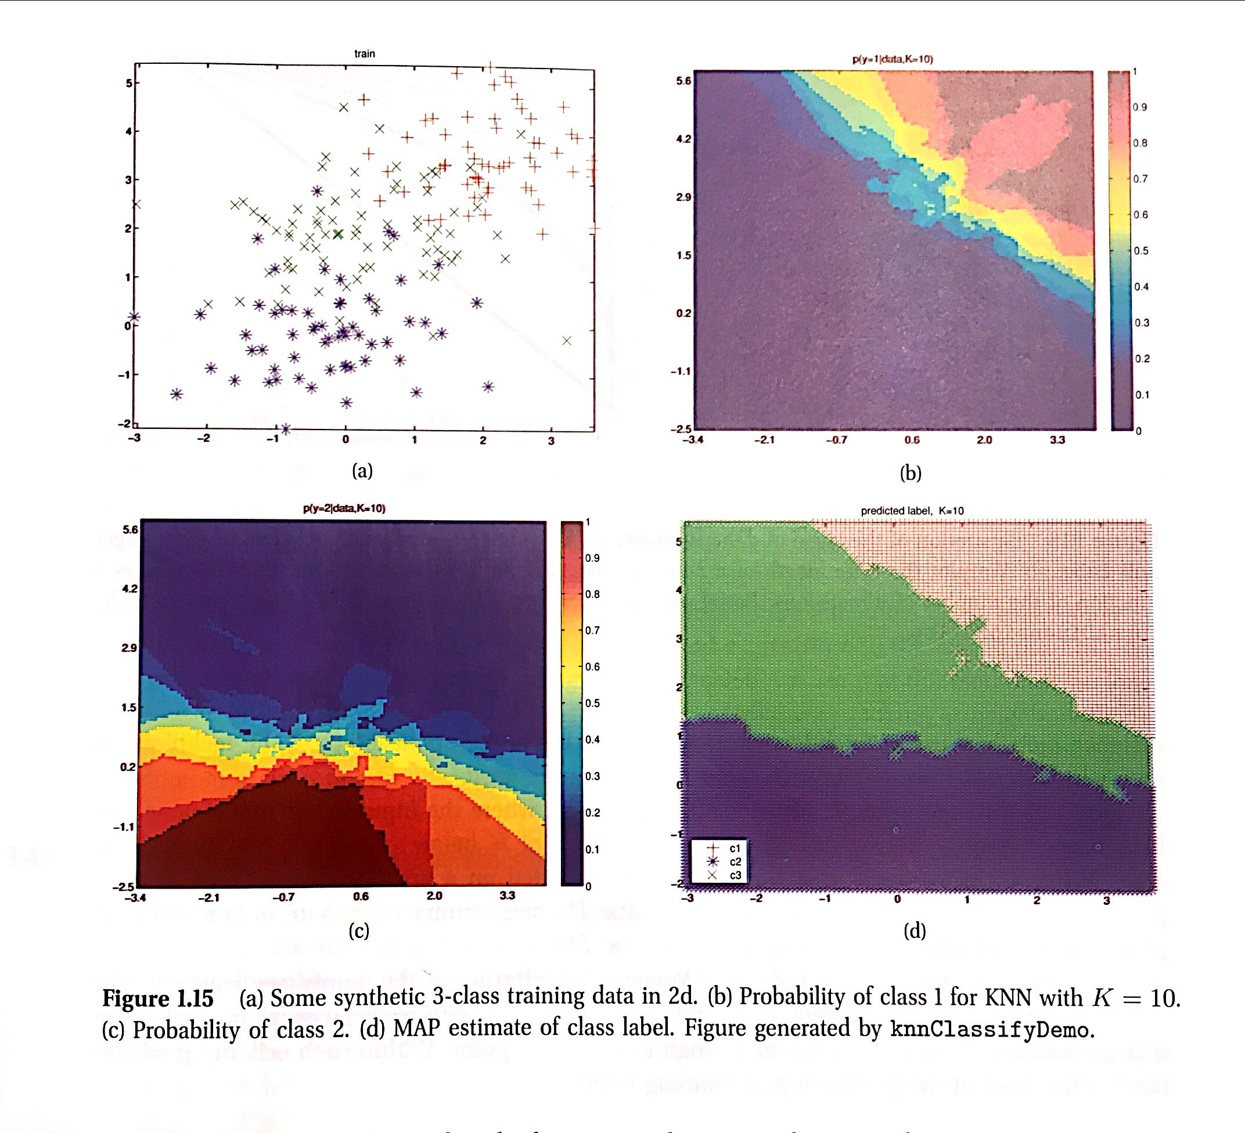
Figure from Machine Learning: A Probabilistic Perspective (Kevin. P. Murphy)

Slide 23
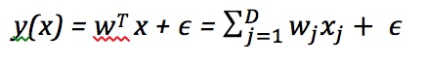
Parametric Models
The main way to resolve the curse of dimensionality is to make some assumptions about the nature of the data distribution (either p(y|x) for a supervised problem or p(x) for an unsupervised problem). These are statistical models with a fixed number of parameters. Some widely used parametric models are described below:
Linear Regression
The most widely used models for regression is known as linear regression. This asserts that the response is a linear function of the inputs. This can be written as follows:

Slide 24
where w^{T}x represents the inner or scalar product between the input vector x and the model’s weight vector w, and ϵ is the residual error between our linear regression and the true response.

Slide 25
Logistic Regression
This is a generalization of linear regression to the (binary) classification, making two changes. First, we replace Gaussian distribution for y with a Bernoulli distribution, which is more appropriate for the case when the response is binary. Second, we compute a linear combination of the inputs. We will revisit this in a future lecture and discuss it in detail.

Slide 26
Overfitting
When we fit highly flexible models, we need to be careful we do not overfit. That is, we should avoid trying to model every minor variation in the input since this is more likely to be noise than true signal. Overfitting results in the data fitted to a high degree polynomial, resulting with a wiggly curve. It is unlikely that the true function has such extreme oscillation. Using such models lead to inaccurate predictions.

Slide 27
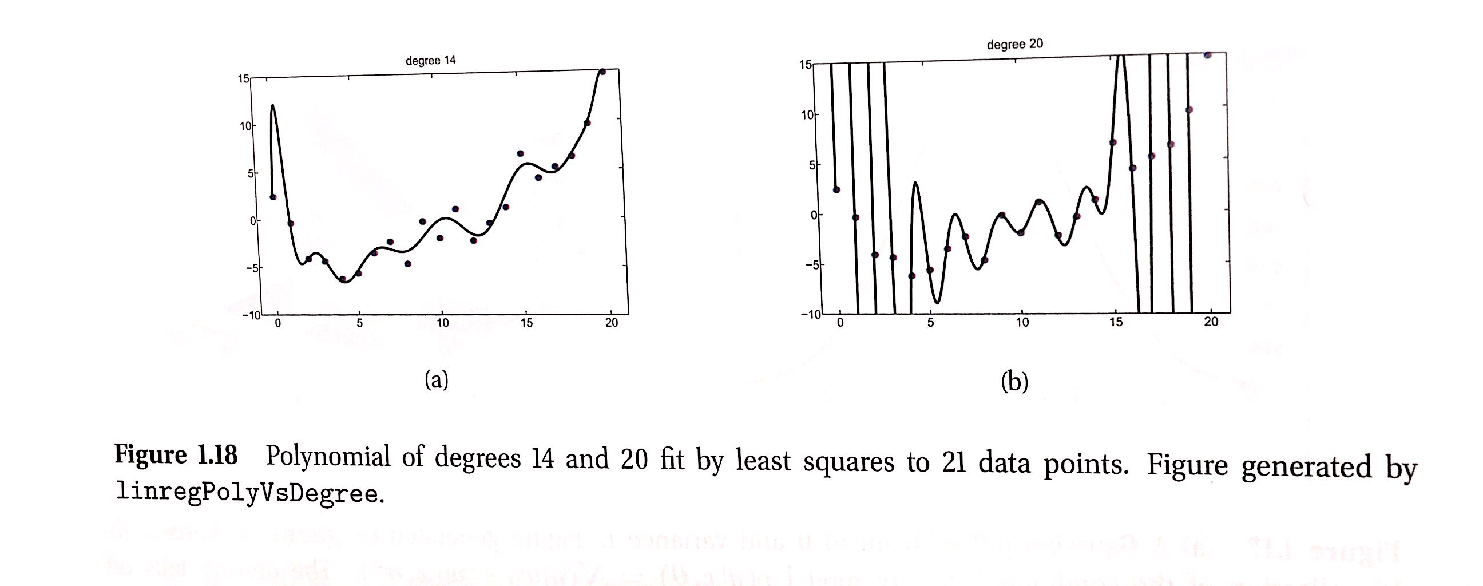
Figure from Machine Learning: A Probabilistic Perspective (Kevin. P. Murphy)

Slide 28
Source of the Material
The material in this lecture are from:
1. Machine Learning: A Probabilistic Perspective
By Kevin P. Murphy Chapter 1.
2. Machine Learning in Action
By Peter Harrington Chapter 1.

